Slide 1
COMPOUND INTEREST
(L – 1)

Slide 2
COMPOUND INTEREST
  Concept of Compound Interest
  Problems related to missing rate, principal and time for Compound Interest
  Concept of half yearly, quarterly interest and monthly
  Problems related to interest/amount being n times of Principal
  Difference between SI and CI for 2 and 3 years
  Miscellaneous Questions
  Data Sufficiency Questions

Slide 3
COMPOUND INTEREST
Basic Terms:
INTEREST: It is money paid by a borrower for using the lender's money for a specified period of time. Denoted by I.
PRINCIPAL: The original sum borrowed. Denoted by P.
TIME: The time period for which the money is borrowed. Denoted by T
RATE OF INTEREST: The rate at which interest is calculated on the original sum. Denoted by R.
AMOUNT: Amount is Sum of Principal plus Interest. Denoted by A

Slide 4
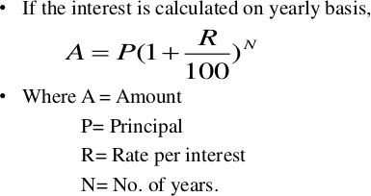
COMPOUND INTEREST
Compound interest is based on the principal amount and the interest that accumulates on it in every period.

Slide 5
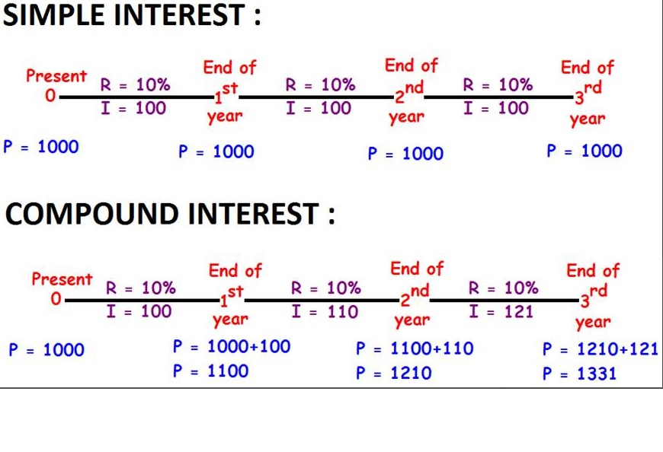
COMPOUND INTEREST

Slide 6
COMPOUND INTEREST
IMPORTANT FORMULAS:
When the interest is compounded Annually:
Amount= P (1 + R/100) ^{n}
When the interest is compounded Half-yearly:
Amount = P (1 + (R/2)/100)^{2n}
When the interest is compounded Quarterly:
Amount = P (1 + (R/4)/100)^{4n}
When the rates are different for different years, say R1%, R2%, and R3% for 1 year, 2 years, and 3-year resp. Then,
Amount = P (1 + R1/100) (1 + R2/100) (1 + R3/100)
Present worth of ₹ x due n years hence is given by:
Present worth = x/ (1 + R/100)^{n}

Slide 7
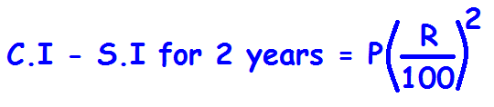
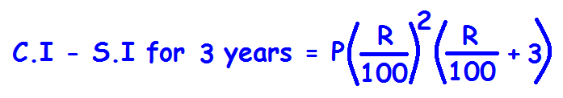
COMPOUND INTEREST
Difference between CI and SI for 2 years:
Difference between CI and SI for 3 years:

Slide 8
COMPOUND INTEREST
1. At what percent per annum will Rs. 3000/- amounts to Rs. 3993/- in 3 years if the interest is compounded annually?
A] 5 % B] 7 %
C] 6 % D] 10 %
Notes:
Option D
Compulsory
Difficulty level: Easy

Slide 9
COMPOUND INTEREST
2. A sum becomes Rs. 1,352 in 2 years at 4% per annum compound interest. The sum is
A] Rs. 1225 B] Rs. 1270
C] Rs. 1245 D] Rs. 1250
Notes:
Option D
Compulsory
Difficulty level: Easy

Slide 10
COMPOUND INTEREST
3. The time in which 80,000 amounts to 92,610 at 5% p.a. compound interest, interest being compounded annually is :
A] 1 (1/2) Years B] 2 Years
C] 2 (1/2) Years D] 3 Years
Notes:
Option D
Compulsory
Difficulty level: Easy

Slide 11
COMPOUND INTEREST
4. What will be the compound interest on a sum of Rs. 25,000 after 3 years at the rate of 12 % per annum.
A] Rs. 9000.30 B] Rs. 9720
C] Rs. 10123.20 D] Rs. 10483.20
Notes:
Option C
Compulsory
Difficulty level: Easy

Slide 12
COMPOUND INTEREST
5. The compound interest on Rs. 6,000 at 10% per annum for 1 (1 / 2) years, when the interest being compounded annually, is
A] Rs. 910 B] Rs. 870
C] Rs. 930 D] Rs. 900
Notes:
Option C
Compulsory
Difficulty level: Moderate

Slide 13
COMPOUND INTEREST
6. The compound interest on Rs. 80,000 at 10% per annum for 1 (1 / 2) years, when the interest being compounded semi annually, is
A] Rs. 12500 B] Rs. 12600
C] Rs. 12610 D] Rs. 12900
Notes:
Option C
Compulsory
Difficulty level: Moderate

Slide 14
COMPOUND INTEREST
7. The compound interest on Rs. 10,000 at 20% per annum for 2 Years 3 months, when the interest being compounded semi annually, is
A] Rs. 5355.61 B] Rs. 5565.31
C] Rs. 4265.62 D] Rs. 6254.32
Notes:
Option A
Difficulty level: Moderate

Slide 15
COMPOUND INTEREST
8. The compound interest on Rs. 16,000 for 9 months at 20% per annum, interest being compounded quarterly, is:
A] Rs. 2520 B] Rs. 2524
C] Rs. 2522 D] Rs. 2518
Notes:
Option C
Compulsory
Difficulty level: Moderate

Slide 16
COMPOUND INTEREST
9. The compound interest on Rs. 80,000 for 0.75 year at 40% per annum, interest being compounded quarterly, is:
A] Rs. 20640 B] Rs. 25430
C] Rs. 26480 D] Rs. 21460
Notes:
Option C
Difficulty level: Difficult

Slide 17
COMPOUND INTEREST
10. If the rate of interest be 4% per annum for first year, 5% per annum for second year and 6% per annum for third year, then the compound interest of 10,000 for 3 years will be
A] Rs. 1600 B] Rs. 1625.80
C] Rs. 1575.20 D] Rs. 2000
Notes:
Option C
Compulsory
Difficulty level: Moderate

Slide 18
COMPOUND INTEREST
11. A sum of Rs. 3000 amounts to Rs. 6000 in two years at compound interest. The interest for four years is :
A] Rs. 9000 B] Rs. 12000
C] Rs. 6000 D] Rs. 3000
Notes:
Option A
Compulsory
Difficulty level: Moderate

Slide 19
COMPOUND INTEREST
12. A sum of money invested at compound interest doubles itself in 6 years. At the same rate of interest it will amount to eight times of itself in :
A] 15 Years B] 12 Years
C] 18 Years D] 10 Years
Notes:
Option C
Compulsory
Difficulty level: Moderate

Slide 20
COMPOUND INTEREST
13. A sum of money becomes eight times in 3 years, if the rate is compounded annually. In how much time will the same amount at the same compound rate become sixteen times?
A] 6 Years B] 4 Years
C] 8 Years D] 5 Years
Notes:
Option B
Difficulty level: Moderate

Slide 21
COMPOUND INTEREST
14. If the compound interest on a certain sum for 2 years at 3% per annum is Rs. 101.50, then the simple interest on the same sum at the same rate and for the same time will be:
A] Rs. 90 B] Rs. 95.50
C] Rs. 100 D] Rs. 98.25
Notes:
Option C
Compulsory
Difficulty level: Moderate

Slide 22
COMPOUND INTEREST
15. The compound interest on a certain sum of money at 5% per annum for 2 years is 246. The simple interest on the same sum for 3 years at 6% per annum is
A] Rs. 435 B] Rs. 450
C] Rs. 430 D] Rs. 432
Notes:
Option D
Difficulty level: Moderate

Slide 23
COMPOUND INTEREST
16. At a certain rate per annum, the simple interest on a sum of money for one year is 260 and the compound interest on the same sum for two years is 540.80. The rate of interest per annum is
A] 4 % B] 8 %
C] 6 % D] 10 %
Notes:
Option B
Compulsory
Difficulty level: Moderate

Slide 24
COMPOUND INTEREST
17. The simple interest and compound interest (compounded annually) on a certain sum of money with a given rate for a period of 2 years are 900 and 954 respectively. The sum of money is
A] Rs. 3700 B] Rs. 3650
C] Rs. 3850 D] Rs. 3750
Notes:
Option D
Compulsory
Difficulty level: Moderate

Slide 25
COMPOUND INTEREST
18. The compound interest on a certain sum of money at a certain rate for 2 years is Rs. 40.80 and the simple interest on the same sum is Rs. 40 at the same rate and for the same time. The rate of interest is
A] 2% B] 3%
C] 4% D] 5%
Notes:
Option C
Difficulty level: Moderate

Slide 26
COMPOUND INTEREST
19. The difference between the simple and compound interest on a certain sum of money at 5% rate of interest per annum for 2 years is Rs. 15. Then the sum is :
A] Rs. 6500 B] Rs. 5500
C] Rs. 6000 D] Rs. 7000
Notes:
Option C
Compulsory
Difficulty level: Moderate

Slide 27
COMPOUND INTEREST
20. The difference between compound interest and simple interest on 2500 for 2 years at 4% per annum is
A] Rs. 4 B] Rs. 45
C] Rs. 14 D] Rs. 40
Notes:
Option A
Difficulty level: Moderate

Slide 28
COMPOUND INTEREST
21. If the difference of the compound interest and the simple interest on a sum of money for 3 years is Rs. 186. Find the sum of money, if the rate of interest in both cases be 10%.
A] Rs. 6000 B] Rs. 7200
C] Rs. 6500 D] Rs. 6600
Notes:
Option A
Compulsory
Difficulty level: Moderate

Slide 29
COMPOUND INTEREST
22. The ratio of difference of CI and SI for 3 years to difference of CI and SI for 2 years is 25:8. Find the rate percent per annum.
A] 12.5% B] 15%
C] 20% D] 25%
Notes:
Option A
Difficulty level: Moderate

Slide 30
COMPOUND INTEREST
23. The difference between the compound and the simple interest on a sum for 2 years at 10% per annum, when the interest is compounded annually, is 28. If the interest were compounded half - yearly, the difference in the two interests will be
A] Rs. 44 B] Rs. 28.35
C] Rs. 43.42 D] Rs. 43.49
Notes:
Option C
Compulsory
Difficulty level: Difficult

Slide 31
COMPOUND INTEREST
24. On a certain sum of money lent out at 16% p.a. the difference between the compound interest for 1 year, payable half yearly, and the simple interest for 1 year is Rs. 56. The sum is
A] Rs. 1080 B] Rs. 7850
C] Rs. 8750 D] Rs. 5780
Notes:
Option C
Compulsory
Difficulty level: Difficult

Slide 32
COMPOUND INTEREST
25. A sum of money amounts to 4,840 in 2 years and to 5,324 in 3 years at compound interest compounded annually. The rate of interest per annum is :
A] 10 % B] 9 %
C] 11 % D] 8 %
Notes:
Option A
Compulsory
Difficulty level: Difficult

Slide 33
COMPOUND INTEREST
26. A sum of money invested at compound interest amounts to Rs. 650 at the end of first year and Rs. 676 at the end of second year. The sum of money is :
A] Rs. 600 B] Rs. 540
C] Rs. 625 D] Rs. 560
Notes:
Option C
Compulsory
Difficulty level: Difficult

Slide 34
COMPOUND INTEREST
27. Rs. 6100 was partly invested in scheme A at 10% per annum CI for 2 years and partly in scheme B at 10% per annum simple interest for 4 years. Both the schemes give equal interest. How much was invested in scheme A?
A] Rs. 3250 B] Rs. 2500
C] Rs. 4000 D] None of these
Notes:
Option C
Difficulty level: Difficult

Slide 35
COMPOUND INTEREST
28. What was the total compound interest on a sum after 3 years?
The interest after one year was Rs. 100 and sum was Rs. 1000.
The difference between simple and compound interest on a sum of Rs. 1000 at the end of 2 years was Rs. 10.
A] I alone sufficient while II alone not sufficient to answer
B] II alone sufficient while I alone not sufficient to answer
C] Either I or II alone sufficient to answer
D] Both I and II are not sufficient to answer
E] Both I and II are necessary to answer
Notes:
Option C
Difficulty level: Moderate

Slide 36
COMPOUND INTEREST
29. What is the compound interest earned by James at the end of 2 years?
Simple interest at the same rate for one year is Rs. 1020 and the rate of interest is 12 percent per annum.
The amount invested is Rs. 8500.
A] I alone sufficient while II alone not sufficient to answer
B] II alone sufficient while I alone not sufficient to answer
C] Either I or II alone sufficient to answer
D] Both I and II are not sufficient to answer
E] Both I and II are necessary to answer
Notes:
Option A
Difficulty level: Difficult

Slide 37
COMPOUND INTEREST
30. Mitchell deposits an amount of money in a savings account that pays compound interest. He does not deposit or withdraw during that time. How much money does he have at the end of five years?
Statement I: Mitchell deposited Rs. 10,000.
Statement II: The savings account draws annual interest of 2.12%, compounded quarterly.
A] I alone sufficient while II alone not sufficient to answer
B] II alone sufficient while I alone not sufficient to answer
C] Either I or II alone sufficient to answer
D] Both I and II are not sufficient to answer
E] Both I and II are necessary to answer
Notes:
Option E
Difficulty level: Moderate

Slide 38

Any Doubts???

